Slide 1




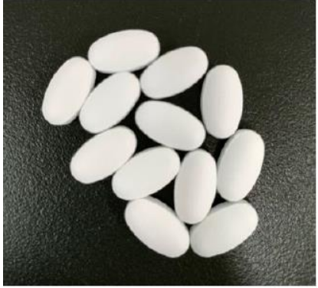
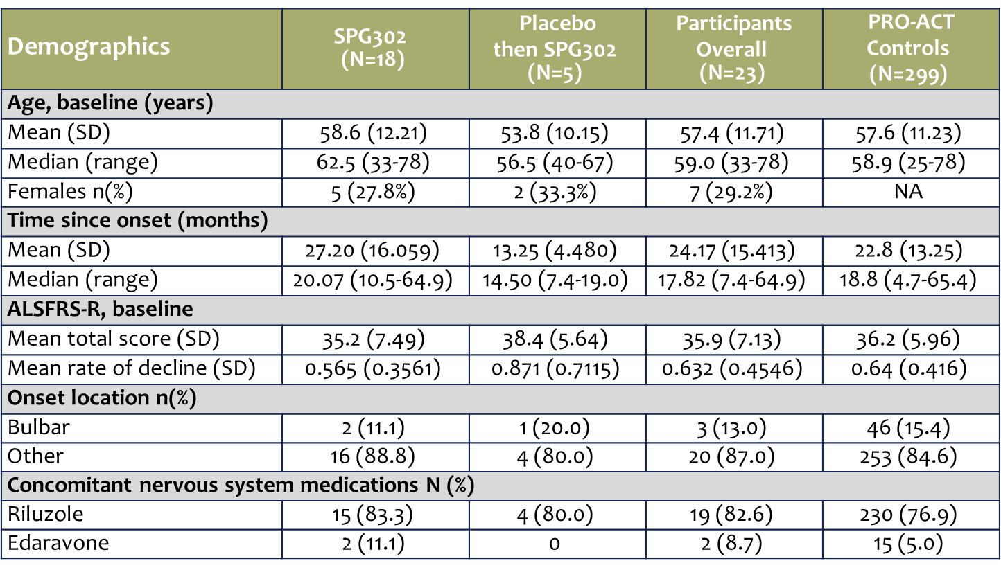
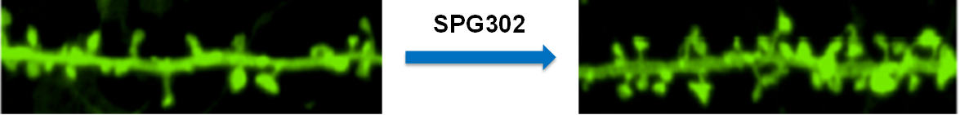
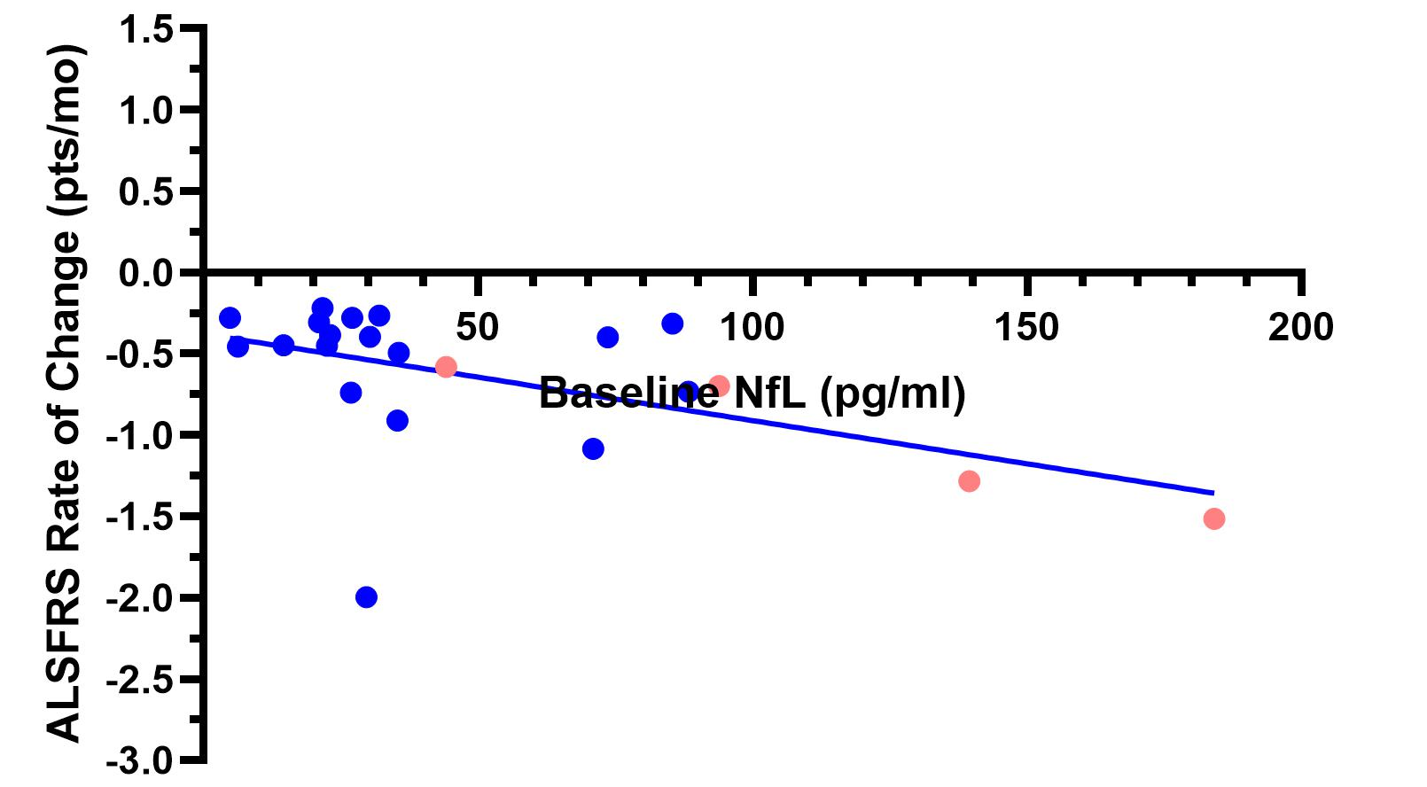
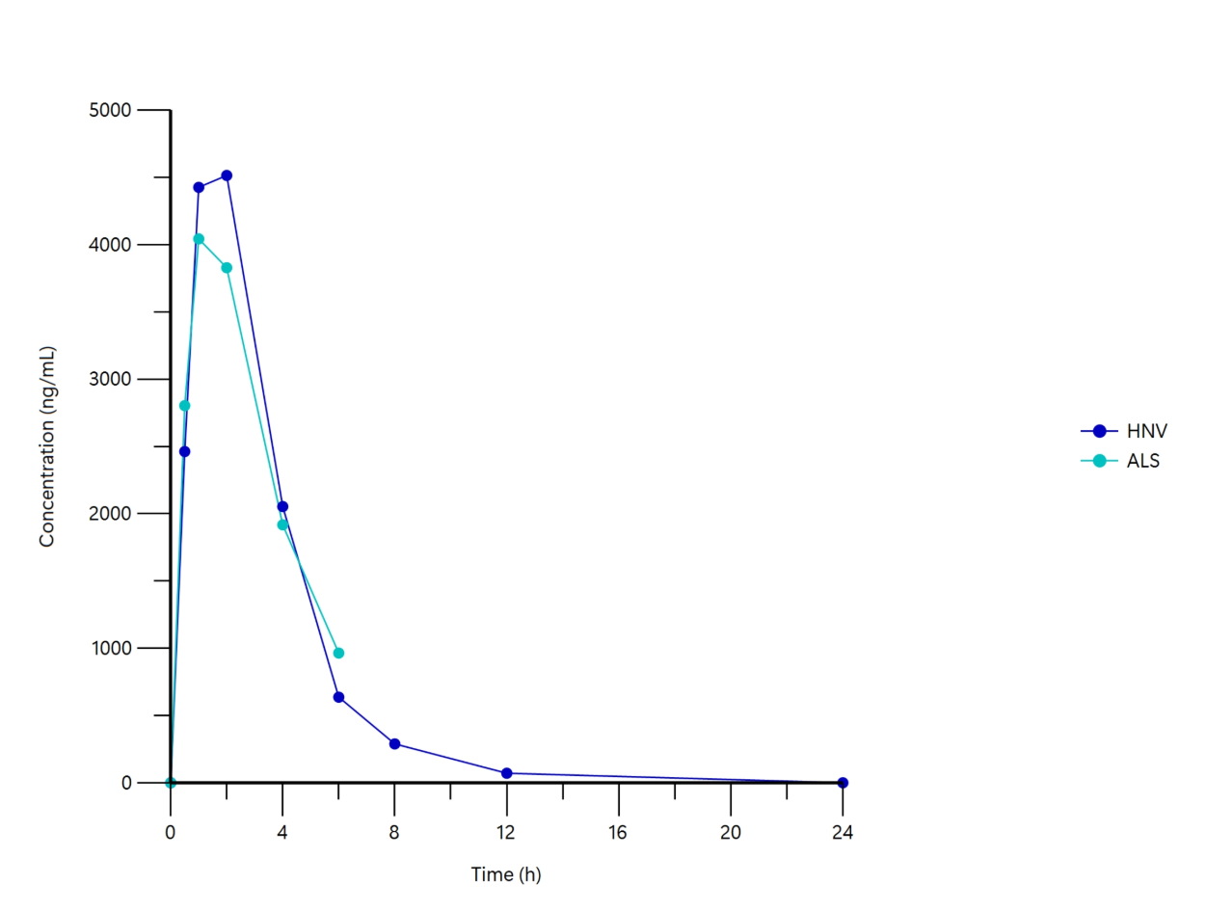
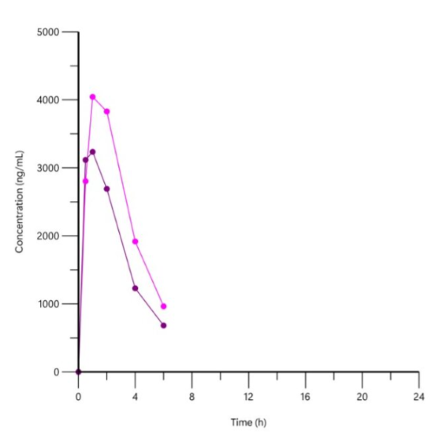

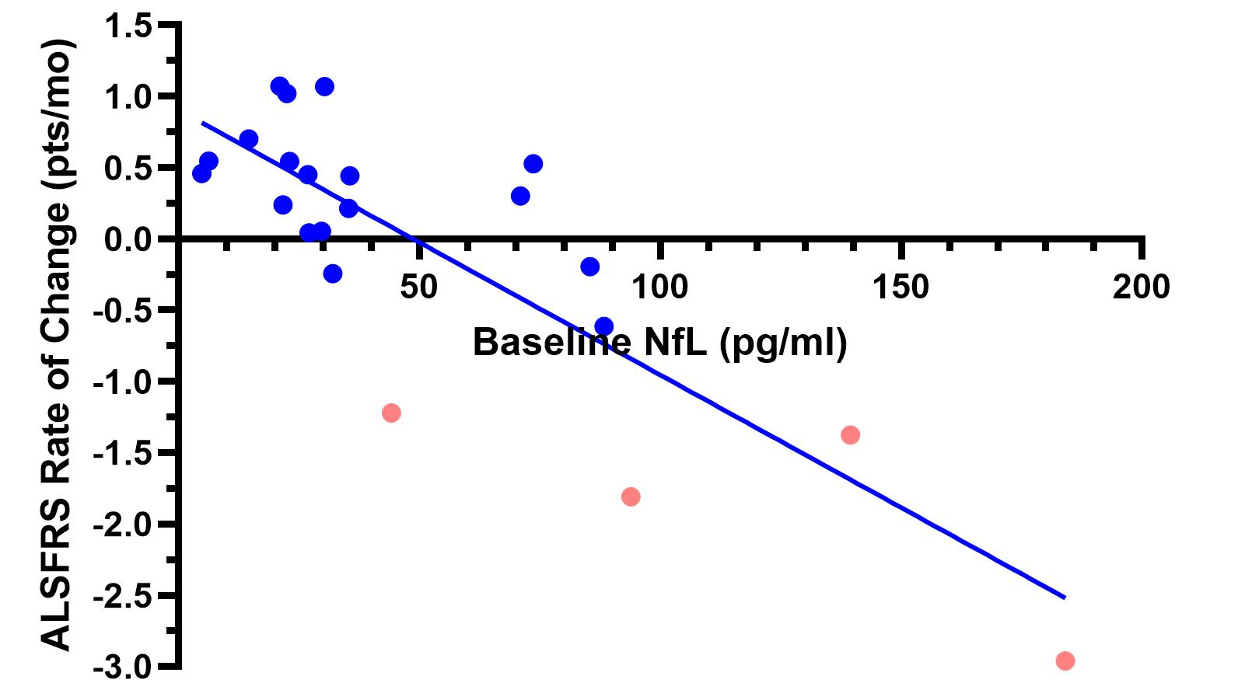
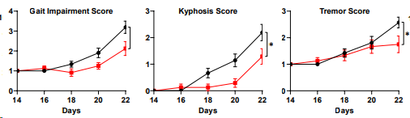
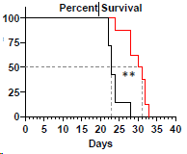
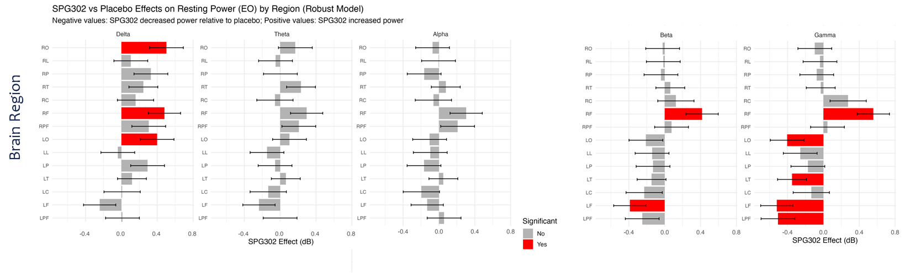
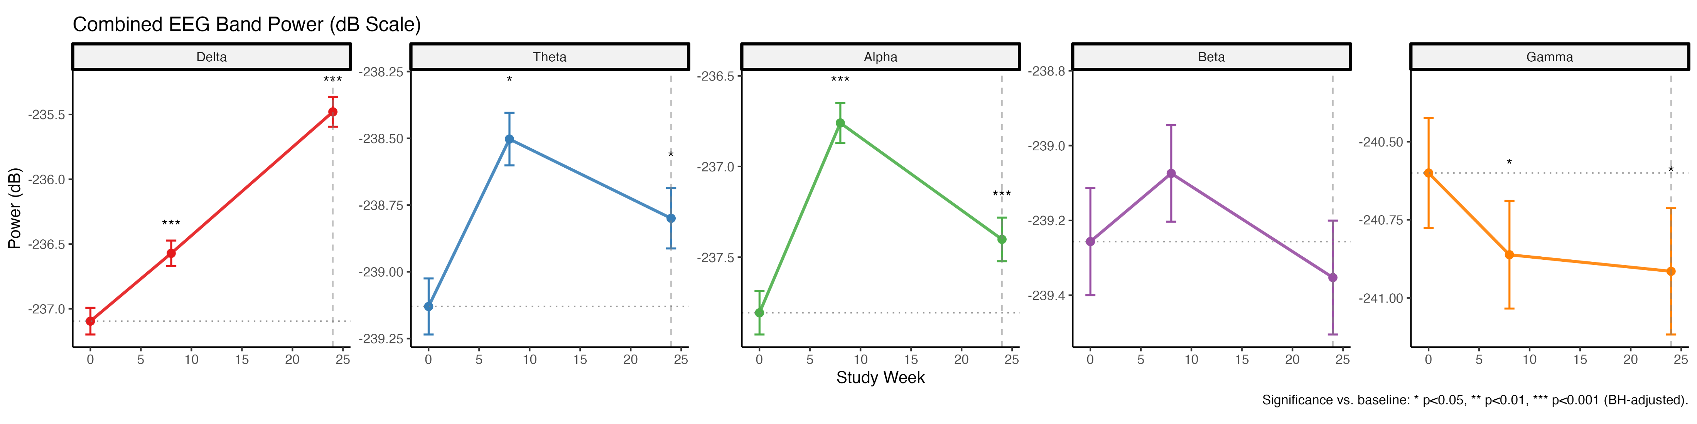
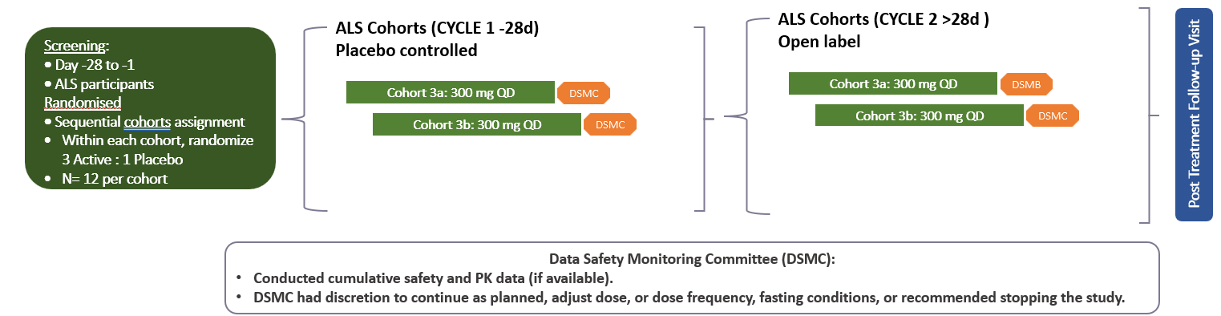
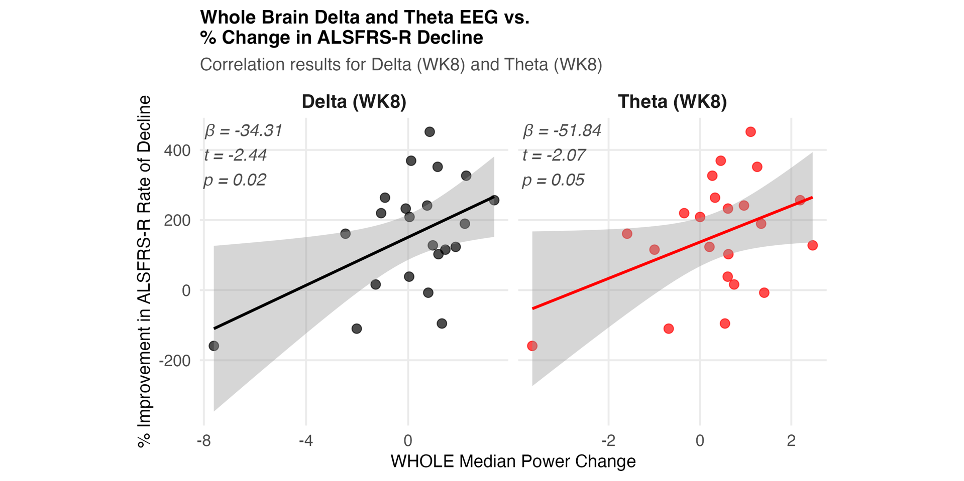
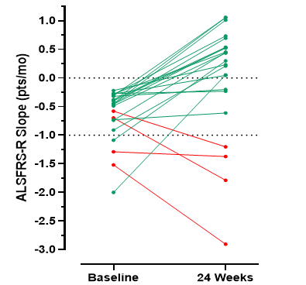
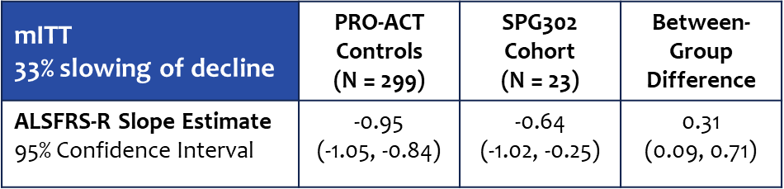
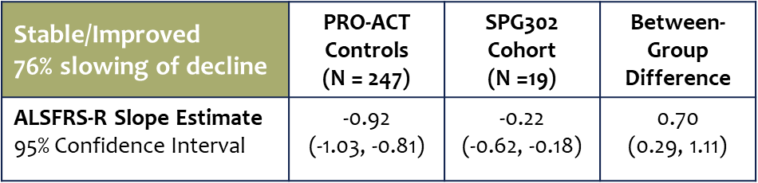
Phase 2a Topline Clinical Results Evaluating Neurophysiological and Functional Measures in
SPG302-treated ALS Participants
Dominic Rowe ¹, Robert Henderson ², David Shultz ³, Richard Gans ¹, Susan Heggie ², Karalyn Ernst ³, Christopher Schuring ⁴, Stephan Mynhardt ⁴,
Sharron Gargosky ⁴, Craig Erickson ⁴, Peter Vanderklish ⁴, Stella T Sarraf ⁴
¹ Macquarie University, Australia; ² University of Queensland, Australia; ³ Flinders Medical Center, Australia; ⁴ Spinogenix, USA
Background
Demographics
Safety
Pharmacokinetics
NfL
SPG302
Novel, first-in-class
Rapid-acting
Small molecule administered as an oral tablet
Regenerates dendritic spine density in vitro & in vivo.
No laboratory abnormalities associated with SPG301 at 300mg QD
No vital sign changes associated with SPG302
Treatment Emergent Adverse Events - 4/24 (16.7%) 3 related to elevated liver enzymes (one grade 3 and drug withdrawn due to immunological disease; one grade 2 and grade 1 with dose not changed nor stopped); one case of grade 1 skin rash (dose not changed)
Serious Adverse events- all unrelated (pulmonary embolism, pneumonia aspiration, respiratory failure, vomiting, and joint injury)
One case of death due to accidental drowning
SPG302 pharmacokinetics are characterized by early attainment of maximal plasma concentrations after oral administration, with a rapid terminal half-life.
Very comparable between healthy volunteers and patients with ALS
Daily dosing of SPG302 is associated with a time-dependent reduction in SPG302 exposure, which appears to stabilize after 28 days of treatment.
NfL is a prognostic measure
higher baseline NfL = faster rate of decline
lower baseline NfL = slower progression
Illustration of SPG302 effects on dendritic spine density in vivo (CA1 apical dendrites)
Baseline NfL vs Baseline ALSFRS Slope
In ALS, dendritic spine synapse loss is a very early event in ALS pathogenesis that is common to all forms of the disease.
Promoting the regeneration of dendritic spine synapses in ALS offers the potential to improve functional recovery and a new treatment approach in ALS.
Baseline NfL vs 24 Week ALSFRS Slope
Preclinical mouse models including TAR4/4 TDP43 (presented at ALSOne) support the synaptic regeneration hypothesis. Results showed improvement of gait, and slowing of functional decline, delayed onset of kyphosis and progression of tremors as well as survival.
ALS Day 1
and HV Day 1
ALS Day 1
and D28
ITT population modified after 1 participant in cohort of 24 was misdiagnosed
SPG302 Normalizes Signature ALS Changes in Resting State EEG
This poster presents results from a Phase 1/2a study (NCT05882695) of SPG302 in ALS participants assessing safety, tolerability, and preliminary efficacy in neurophysiological and functional outcomes.
IND154637 cleared in USA
Orphan Drug Designation in USA and EU
Rapid Rescue Effects During Double-Blind Placebo Controlled Period
SPG302 treatment was associated with significant improvements in multiple spectral bands and brain regions
Resting state (eyes open) EEG recordings were obtained in ALS participants at baseline and week 4, and differences between spectral power were measured
Resting state (eyes open) EEG recordings were obtained in ALS participants
Clinical Trial Design (ALS)
Randomized (3:1), 24 patients clinically definite or probable ALS as defined by Treatment Research Initiative to Cure ALS (TRICALS) risk score of -2 to -6 and SOC if on a stable dose for at least 28 days prior to dosing.
Double blinded, 4 weeks (cycle) followed by an open label of 48 weeks. Stopped at 24 wks and patients offered Special Access Scheme (SAS)
Replication – our placebo cohort replicated prior published EEG findings in ALS (Trubshaw 2024; Dukic 2019)
SPG302 shows statistically significant rescue effects in ALS after only 4 weeks of treatment
  normalizes brain EEG power across delta and gamma frequencies
  significant SPG302-associated changes map to regions with established EEG power abnormalities
Durability – SPG302-associated EEG power improvements observed at 4 weeks continue at 8 and 24 weeks
    Increasing delta, theta, and alpha power and reduction in excessive gamma power
    SPG302 effects observed in whole brain and specifically in motor cortex
Dose: 300mg oral QD
Primary Endpoint – Safety & Tolerability
Clinical Outcome Measures – ALSFRS-R and NfL
Neurophysiological Measures (to confirm pharmacological activity) – EEG, ERP, TMS assesses efficacy in normalizing ALS signature changes in brain activity
SPG302 Slowed The Rate of Decline in ALSFRS-R
EEG Changes Predict ALSFRS-R Benefit
Phase 1 Healthy Volunteer Summary
Analysis of Slope: Baseline vs 24 weeks
Comparison to the PRO-ACT Database SPG302 showed potential benefit in terms of reduced decline in ALSFRS-R at 24 weeks
Significant and Durable Benefits Over 24 Weeks of Treatment in d, q, a and g bands
SPG302 demonstrated a favorable safety and tolerability profile in doses up to 600 mg daily
No SAEs; 8 TRAEs (6 Grade 1, 2 Grade 2)
Dose proportional exposure, negligible food effect
T1/2 1-2hrs, no accumulation across days
Doses well below NOAEL achieved exposures in anticipated efficacy range
Rate of change in ALSFRS-R estimated at baseline (pre-treatment) and at 24 weeks
Mean ALSFRS-R scores (±SD) from baseline to 24 Weeks for PRO-ACT controls (n=299)
mITT population (n=23), stable/improved participants (ALSFRS-R slope ≥ 0 at 24 weeks; n=19), and participants that worsened (ALSFRS-R slope ≤ 0 at 24 weeks n=4).
Whole brain median power changes in a and q bands at 8 weeks were plotted vs the percent improvement in ALSFRS-R slope at 24 weeks
Early SPG302-associated increases in a and q band power predicted benefits in ALSFRS-R trajectory at 24 weeks
SAD – AUC
SAD – Cmax
MAD – AUC
MAD – Cmax
Stabilizing or Improving
ALSFRS-R Slope at 24 Weeks
Worsened ≤ 0 ≥ Stable/Improved
Worsening in rate of decline
25mg
75mg
150mg
300mg
600mg
SPG302 treatment was associated with an overall improvement in ALSFRS-R trajectory at 24 weeks
Conclusions
An average of 13 PRO-ACT controls were matched to each SPG302-treated participant.
Summary statistics for the overall mITT and stable/improved groups are shown in tables.
Support functional benefit – SPG302-associated EEG effects at Week 8 and 24 predict ALSFRS benefits
  Week 8 and 24 Delta power increases in whole brain correlate with reduction in ALSFRS decline at week 24
  Correlation between reduction in whole brain Gamma power reduction and reduction in ALSFRS decline
  Similar correlations in motor cortex (a logical finding in ALS)
manuscript in preparation
Favorable safety and tolerability
Dose proportional pharmacokinetics across HV and patients
Observed significant directional changes in efficacy measures of SPG302 using EEG and ALSFRS
Significant and durable rescue of ALS signature changes in EEG power
Preliminary evidence of benefit in ALSFRS
Correlation of SPG302-associated EEG changes and ALSFRS outcomes
Stabilizing or Improving
Worsening in rate of decline
Acknowledgements
We give special thanks to all the ALS patients, caregivers and family for their participation, and the site staff and teams for all their efforts.

