Slide 1



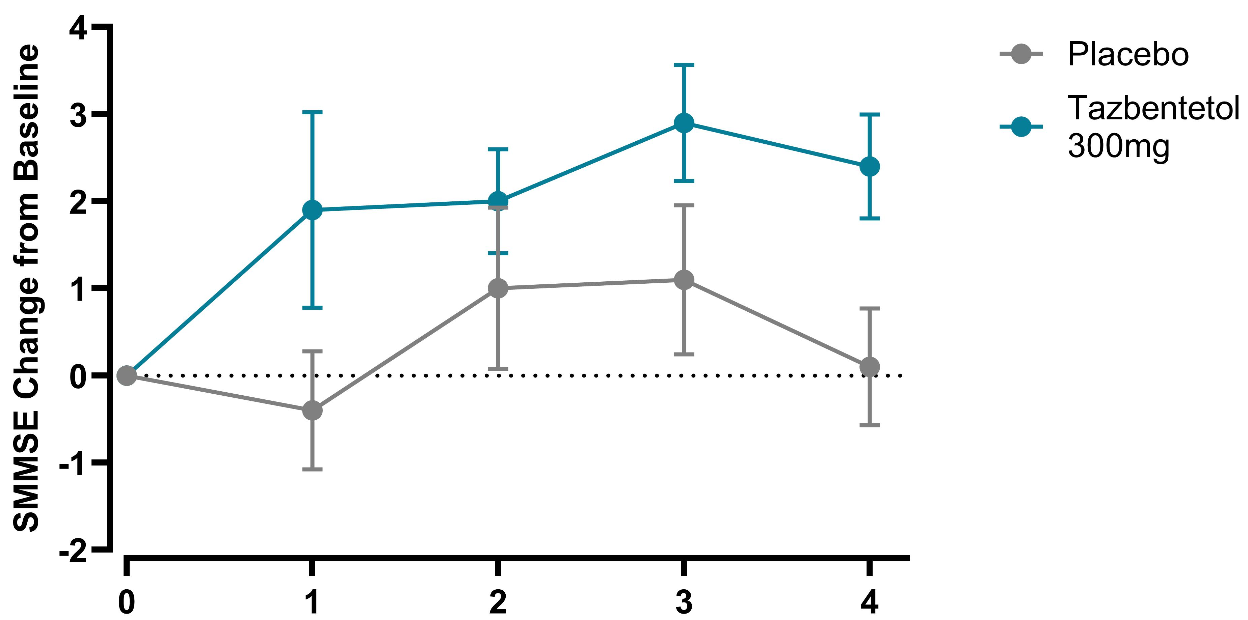
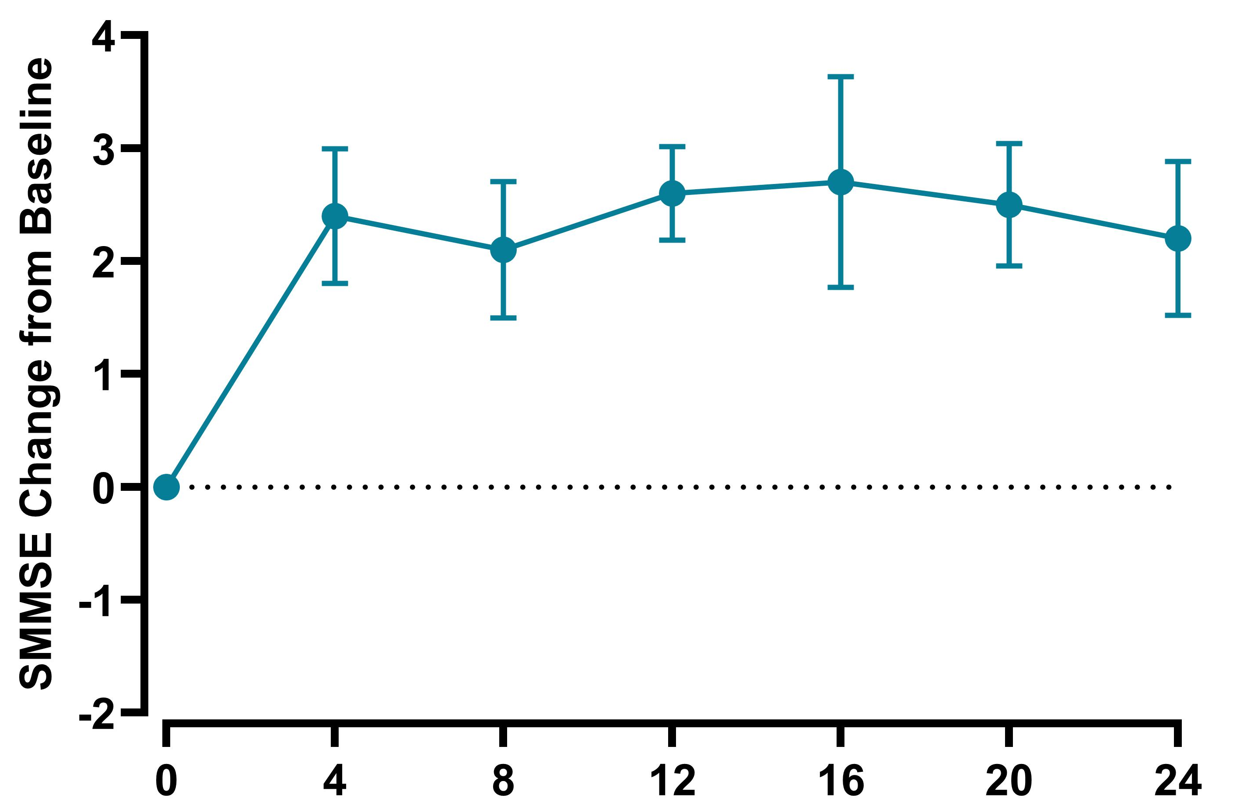
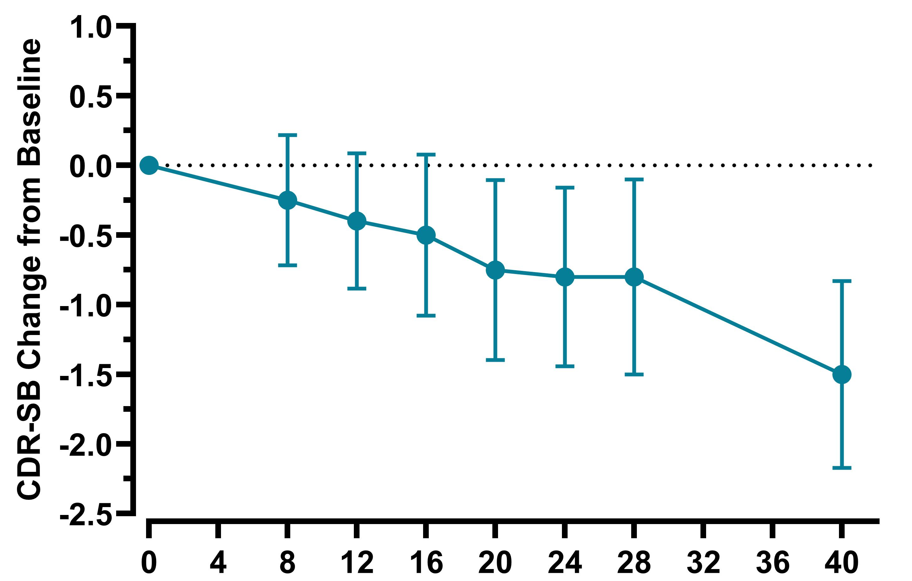
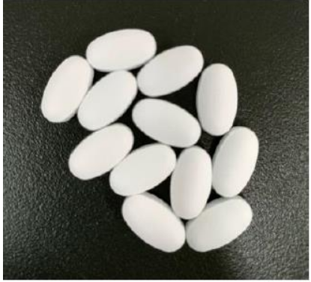
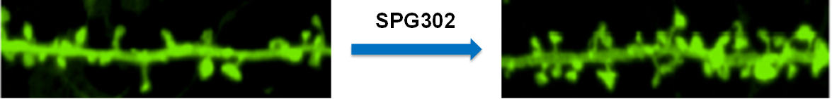
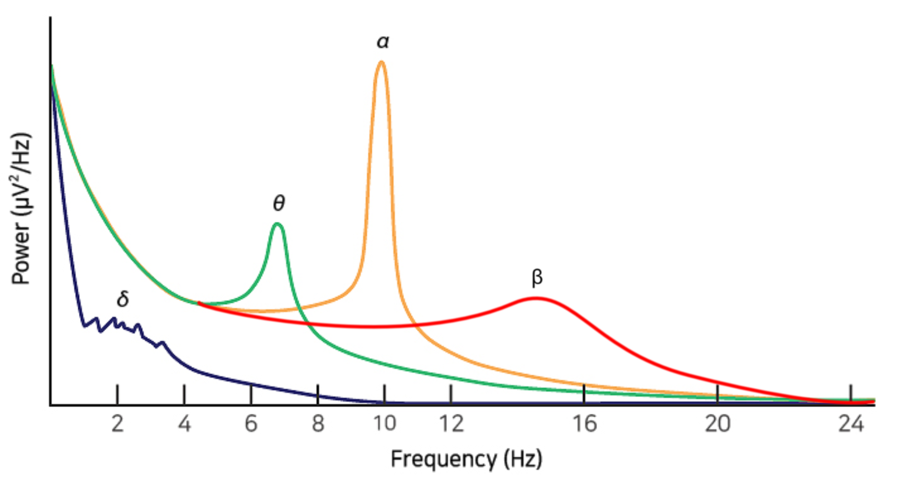
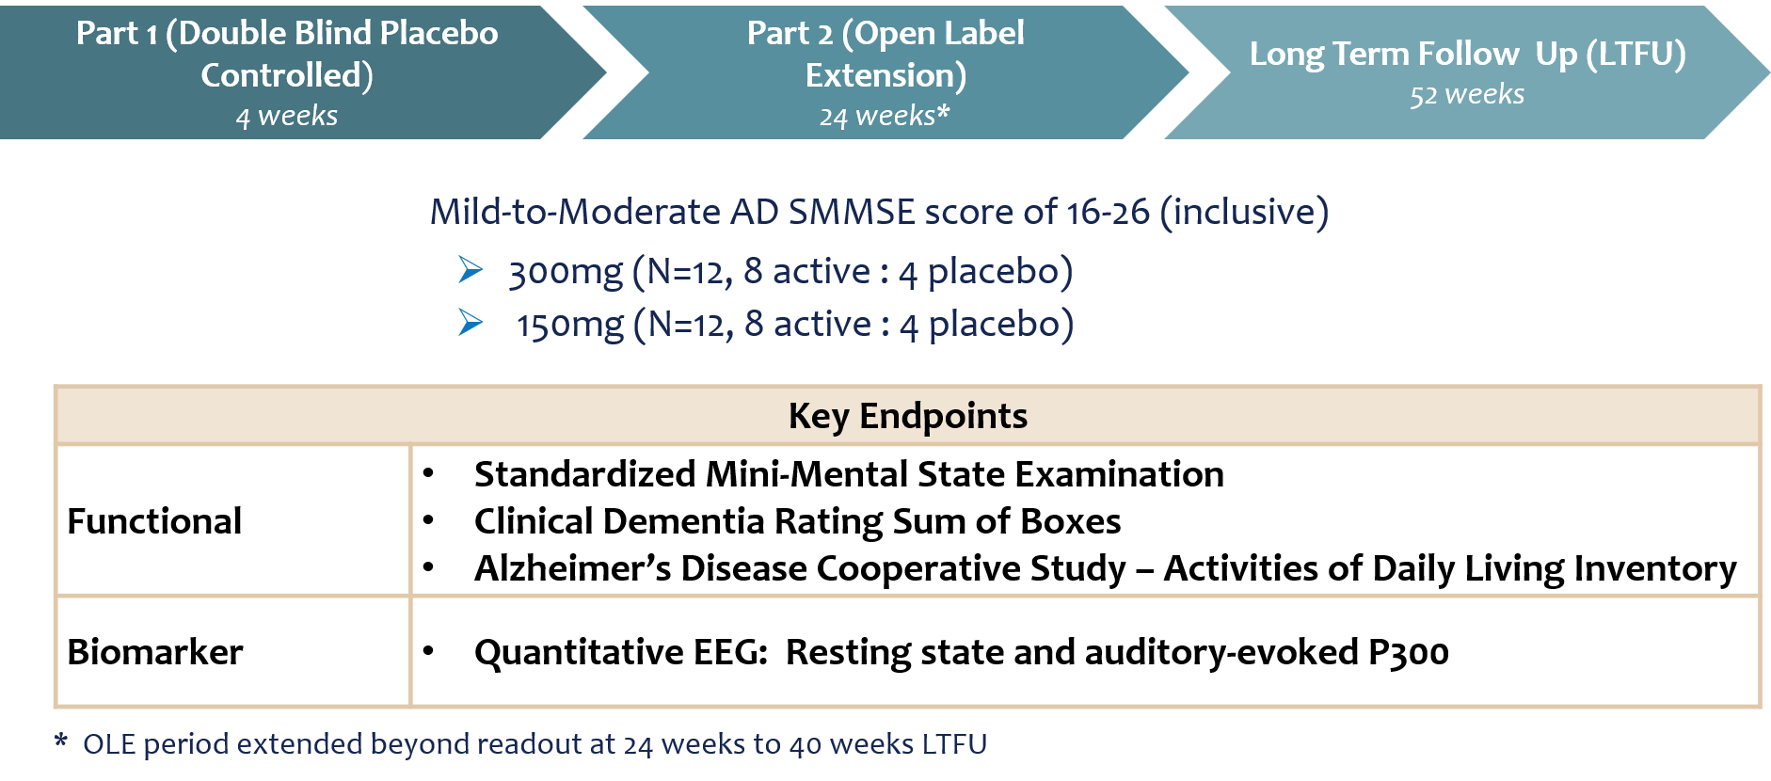
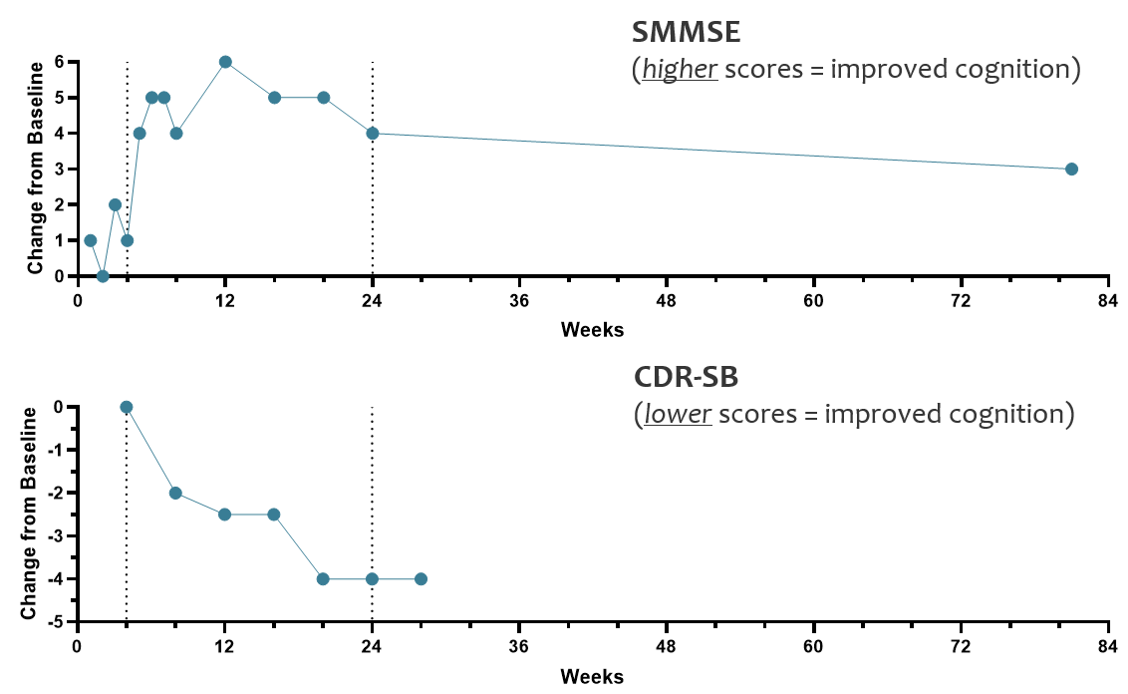
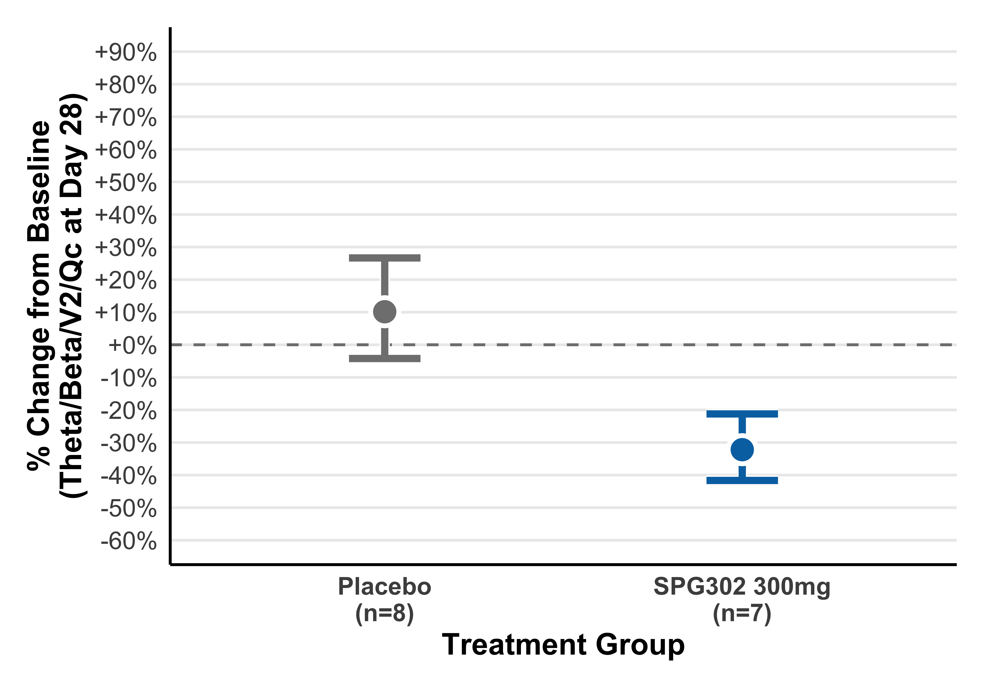
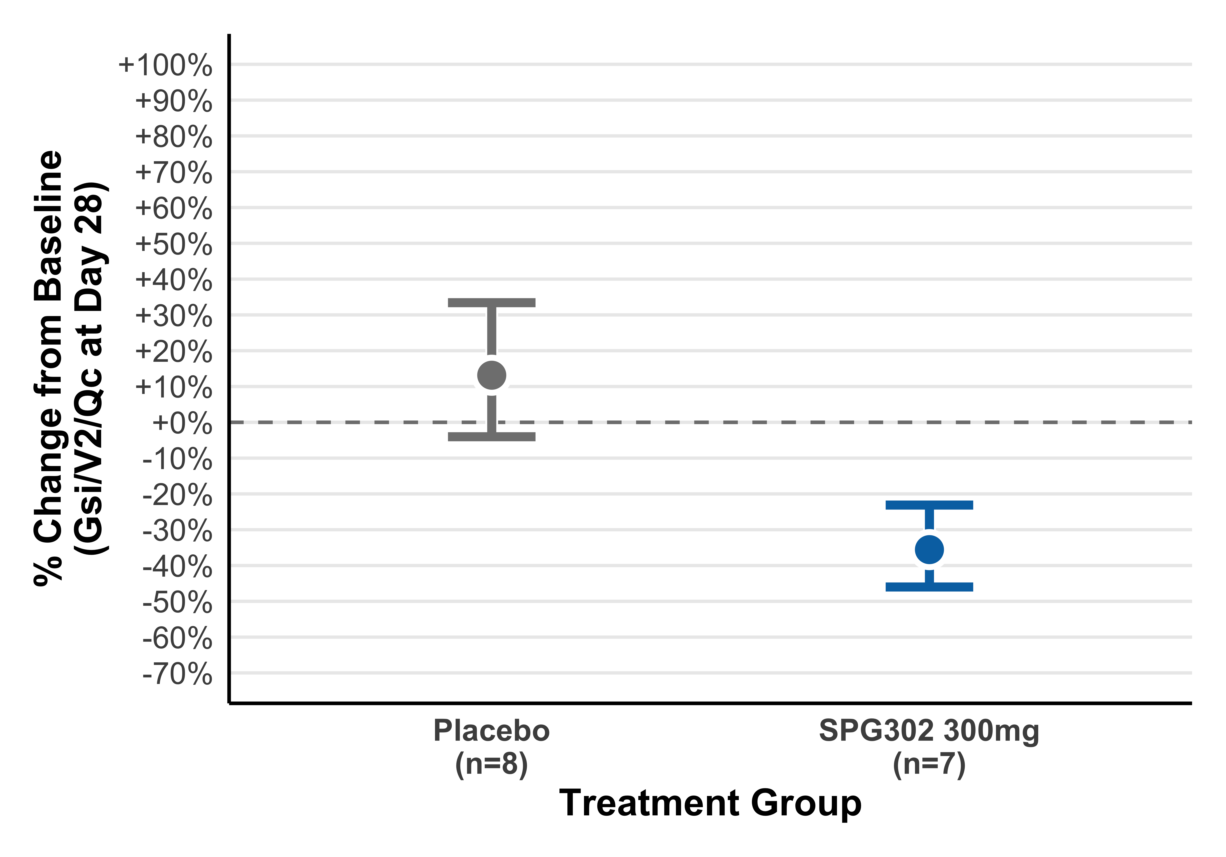
Rapid and Durable Improvements in Cognitive and Neurophysiological Outcomes
in mild-to-moderate AD patients treated with the synaptic regenerative drug, Tazbentetol
Lauren Priest¹, Bruce Brew², Aimee Cazyer¹, Valerie Bramah², Peter Vanderklish⁴, Craig Erickson^{3,4}, Ernest Pedapati^{3,} Sharron E Gargosky⁴, Stella T. Sarraf⁴
¹ Flinders Medical Center, Australia; ² St Vincent’s Hospital, Australia; ³ CinciNeuro, USA; ⁴ Spinogenix, USA
BACKGROUND
Results
Glutamatergic synapse loss is a core feature of Alzheimer’s pathogenesis *
starts early, before symptoms
correlates with cognitive decline
point of convergence among diverse pathogenic processes
having more synapses is associated with cognitive resilience in the face of AD pathology
Tazbentetol (SPG302) is being developed as the first synaptic regenerative therapy for Alzheimer’s
Safety & Tolerability
Efficacy – SMMSE and CDR-SB (all participants)
Safety & Tolerability in AD participants mirrors the excellent profile observed in healthy adults in Phase 1, Phase 2 ALS and SCZ cohorts, and an intermediate sized expanded access protocol (ISEAP) in ALS (>35,000 doses)
No clinically significant shifts or safety signals in hematology, chemistry, vital signs
Most common treatment-emergent adverse events (TEAEs): Infections 30.4% at 24 weeks .TEAEs were unrelated to the study drug. One serious adverse event: femoral neck fracture
SMMSE
SMMSE 11-item questionnaire to assess mental status
Higher scores = improvement
Open Label Extension
52-84 Weeks of Dosing
CDR-SB
CDR-SB - Interviews of patient & care giver
Higher scores = greater impairment
Double- Blind Placebo-Controlled Period
Historical trajectory of worsening ~ +0.7 pts over 6mo
p <0.05
p < 0.05
N = 10
TAZBENTETOL
DBPC
Historical trajectory of worsening of ~3.4pt per year
Typical decline over same time frame
SAS
novel, first-in-class
rapid-acting
synaptic regenerative
small molecule administered as an oral tablet
regenerative – promotes the formation of new dendritic spine synapses
Visit (weeks)
Visit (weeks)
1
Visit (weeks)
8 pooled placebo and 8 on 300 mg
8 at 300 mg 0-4 wks then all 12 in cohort 300mg after 4 wks
N=10
N=6
Rapid, significant improvement during DBPC period
Pharmacodynamic marker – EEG (all participants)
CASE STUDY
tazbentetol
Treatment goal: reduce low/high frequency ratios, restoring faster, more efficient brain function
Initial presentation
72-year-old woman
Baseline SMMSE = 23, mild AD with slow decline
Subject lived at home with husband
Short-term memory loss, anomia, topographical disorientation, emotional lability, impaired social / etiquette skills very impaired
Independent for personal and domestic activities of daily living (ADLs)
Started on 300mg tazbentetol in Sept. 2024
Spousal perceived benefit of treatment
Within 3 months, husband reported:
  able to read a book again (halfway into 2nd book at time of report)
  watching movies again
  able to recall story and plot lines
Illustration of tazbentetol effects on dendritic spine density in vivo (CA1 apical dendrites)
EEG is a neurophysiological outcome measure
Mainly reflects synchronized excitatory synaptic currents
Objective, quantitative, non-invasive, patient-friendly
Sensitive to changes in synaptic function / density *
Two ratios used to measure slowing of activity
Theta / Beta ratio
Global Slowing Index: (δ + θ) / (α + β)
Tazbentetol found to restore synaptic density within 2-4 weeks of daily treatment in preclinical models^{10,11} and in 3 species (mouse, rat, dog)
PHASE 2a TRIAL DESIGN
EEG changes are well established in AD
Signature changes in spectral power and connectivity **
Significant slowing of cortical rhythms, including:
  Increase in “Slow” theta (θ) and delta (δ) frequencies
  Decrease in “Fast” alpha (α) and beta (β) frequencies
Correlates with cognitive decline and pathology **
Clinical outcomes supporting perceived benefit
Rapid, large increase in SMMSE scores during double-blind, placebo-controlled period that increased during open label extension and persisted into the SAS period (last measurement at 81 weeks)
Rapid and large decreases in CDR-SB scores during out to last measurement made at 28 weeks
Increases in these ratios = worsening of disease
EEG biomarker evidence supporting rapid benefit during the placebo-controlled treatment period
Reduced Theta / Beta
  36% reduction
  * p < 0.05
  95% CI: -61% to -4%
  Day 28 endpoint
Reduced Global Slowing Index (GSI)
Demographics
  43% reduction
  * p < 0.05
  95% CI: -54% to -23%
  Day 28 endpoint
Age
n | 24
Mean | 71.5
SD | 8.1
Median | 73.5
Minimum | 51
Maximum | 82
Sex
Female | 50%
Male | 50%
Race
American Indian / Alaska Native | 0%
Asian | 0%
Black or African American | 0%
Native Hawaiian or Other Pacific Islander | 0%
White | 92%
Not Reported | 0%
Other | 8%
Unknown | 0%
Ethnicity
Hispanic or Latino | 0%
Not Hispanic or Latino | 100%
Not Reported | 0%
Unknown | 0%
Clinical Significance
Clinical Significance
  Theta-beta ratio is known biomarker in AD
  Reduction of ratio reflects improved cortical function
  GSI is a composite ratio of slow (δ + θ) to fast (α + β) activity which captures overall cortical slowing burden
  Reduction of ratio reflects improved cortical function
DPBC
Open Label Extension
Long-Term Follow Up (SAS)
CONCLUSIONS for TAZBENTETOL in AD:
Baseline Characteristics
Tazbentetol favorable profile vs approved therapeutics
Favorable safety and tolerability
Evidence of rapid and significant benefit in SMMSE vs placebo
Degree and duration (>1yr) of improvement in SMMSE compare favorably to standard of care (e.g. donepezil affords ~1pt increase in SMMSE over baseline that begins to wane at 6months)
Evidence of rapid benefit in the FDA-approvable outcome measure CDR-SB
Evidence of long-term benefit in CDR-SB that increases over time
EEG neurophysiological biomarker supports normalization of cortical activity, synaptic regeneration and 300mg once daily as active dose
SMMSE ranges:
Normal cognitive function: 27-30
Mild Cognitive Impairment: 21-26
Moderate Cognitive Impairment: 10-20
Severe Cognitive Impairment: <10
Participant recruitment balanced between mild and moderate AD stages as defined by SMMSE
 | 24 Weeks of Treatment (change from baseline)
 | Lecanemab (Clarity AD Ph3) |  | Donanemab (Trailblazer-Alz 2 Ph3) |  | Tazbentetol (Ph2) | Donepezil (10mg)
Outcome | Drug | Placebo | Drug | Placebo | Overall | Drug | Placebo
MMSE lower=impairment | -1.0 | -1.3 | -0.8 | -1.0 | +2.0 | ~ +1.3 | -0.61
CDR-SB higher=impairment | ~ +0.45 | ~ +0.65 | ~ +0.3 | ~ +0.71 | -0.81 | ~ -0.06 | ~ +0.5
p-TAU-217 ranges
Negative: ≤ 0.33 pg/mL
Intermediate: > 0.33 - < 0.56 pg/mL
Positive: ≥ 0.56 pg/mL
Participants had a positive pTau217 result at baseline
Acknowledgements
Results support the hypothesis that synaptic regeneration may be efficacious in restoring cognitive function in AD
  50% of participants were on a stable dose of donepezil prior to trial entry, which was maintained throughout the trial
We want to give special thanks to the patients, their caregivers and family for participating in the trial. We would like to thank the site staff and teams for all the efforts for this trial.

