Slide 1



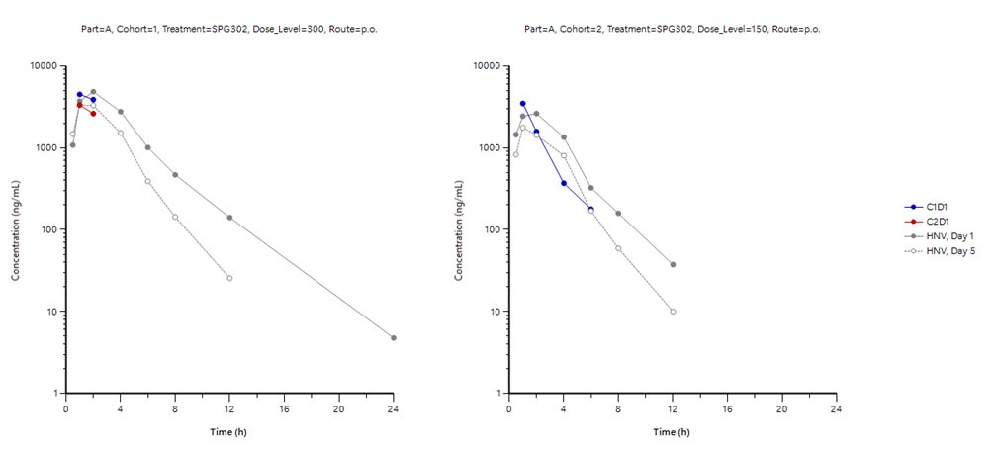
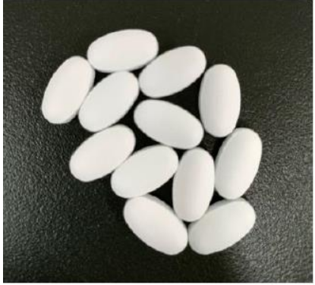
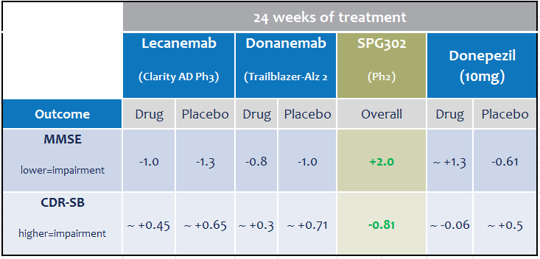
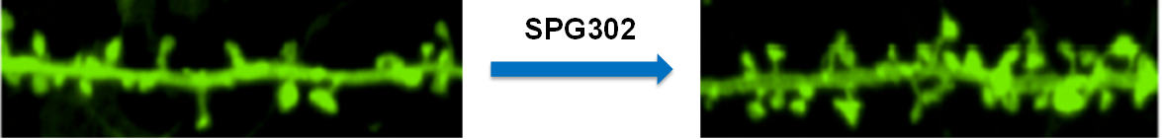
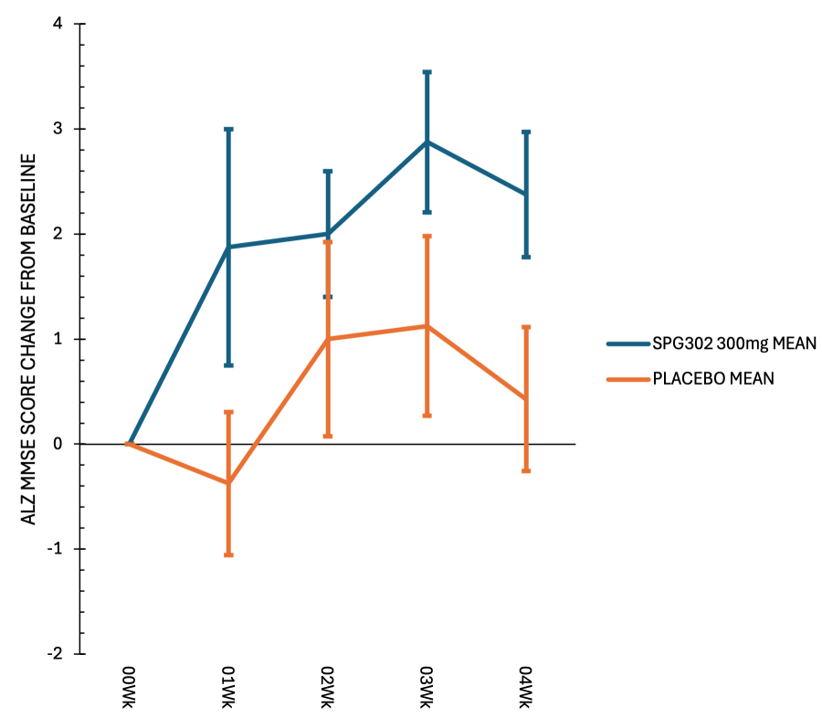
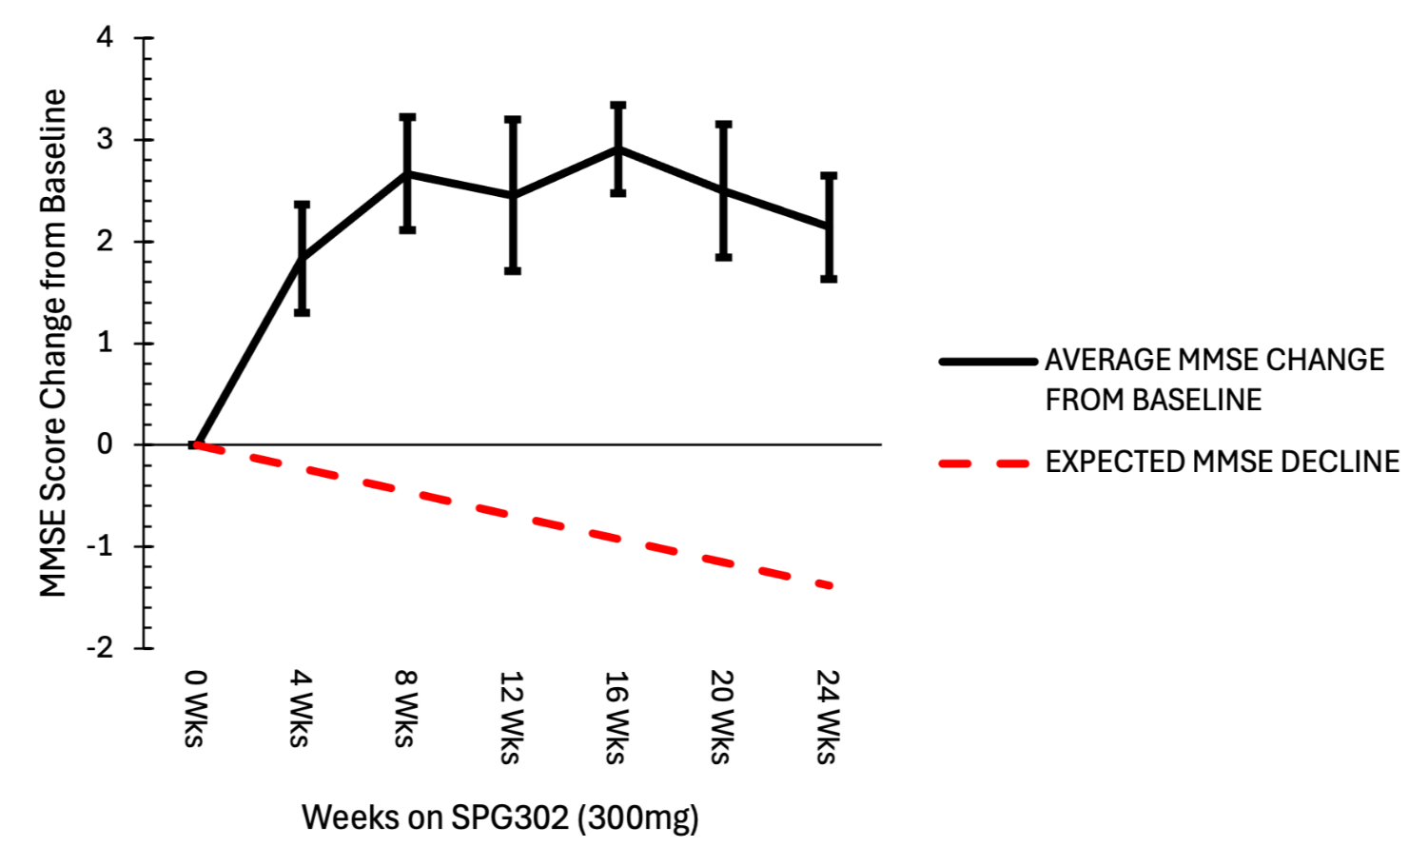
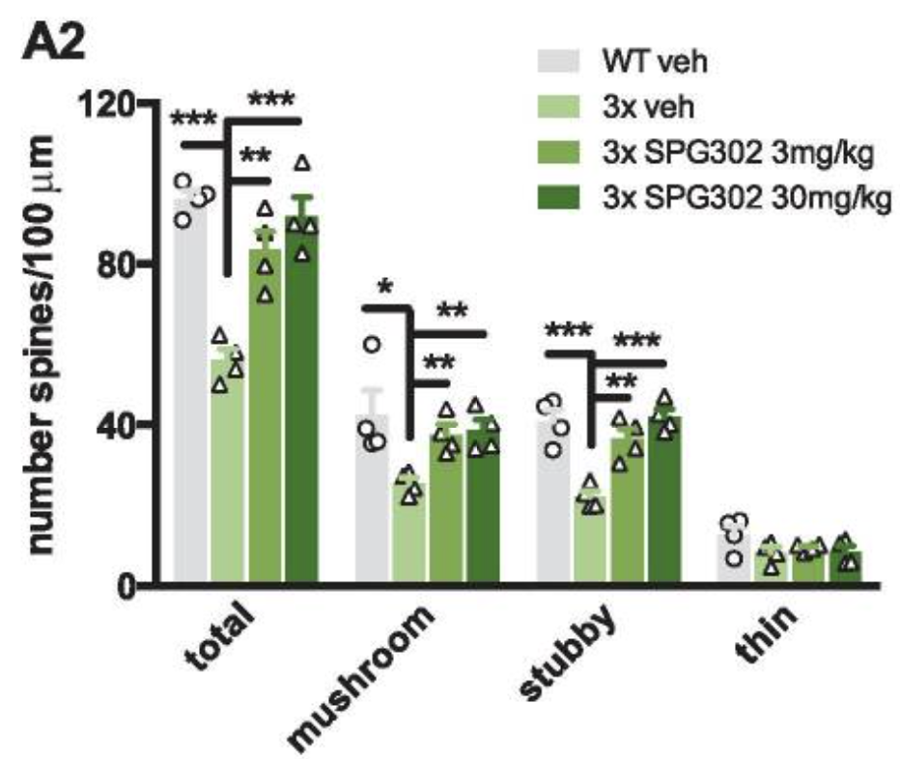
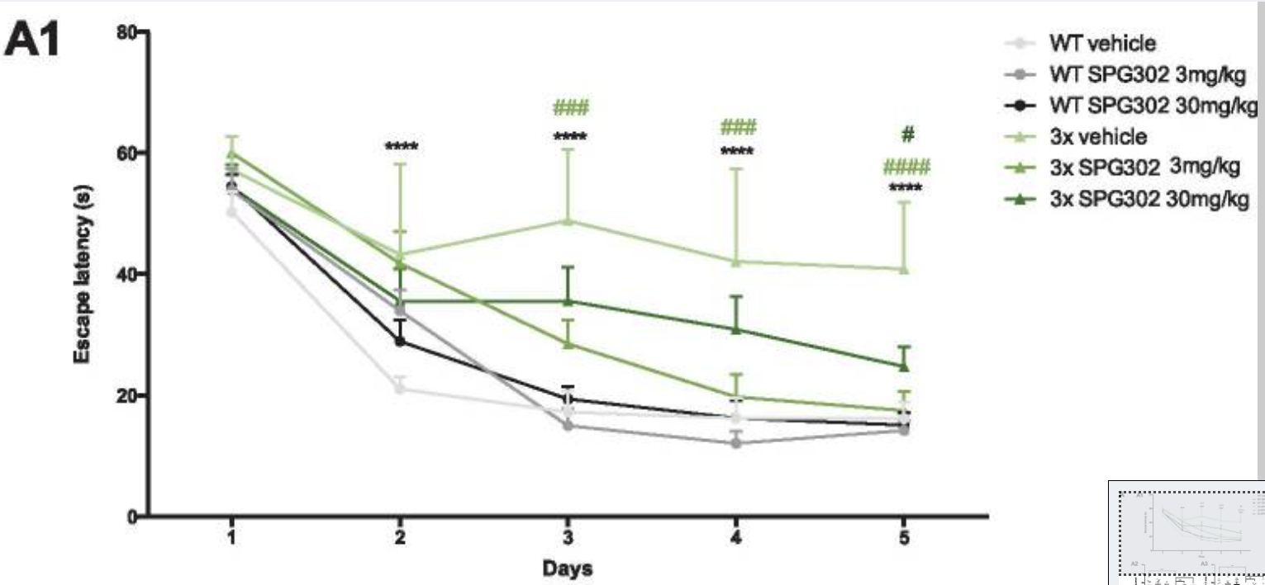
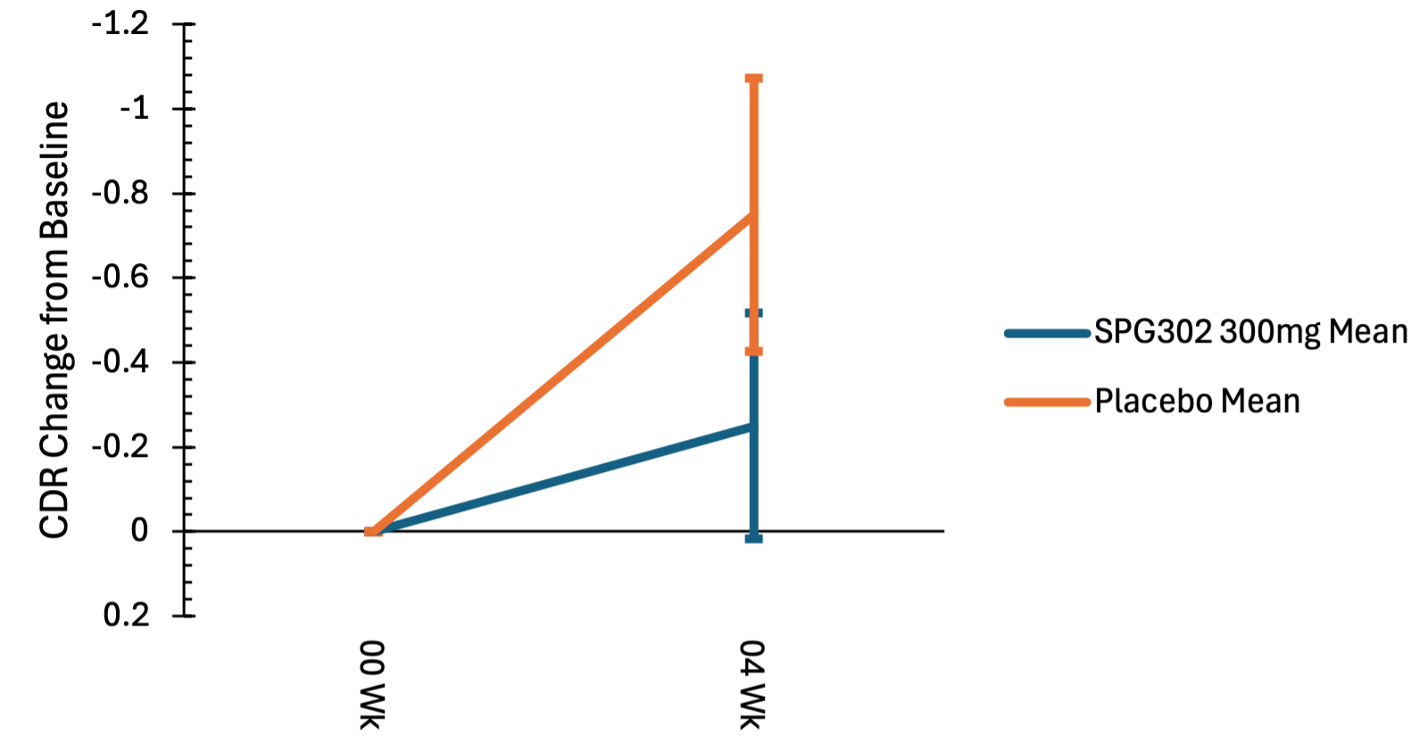
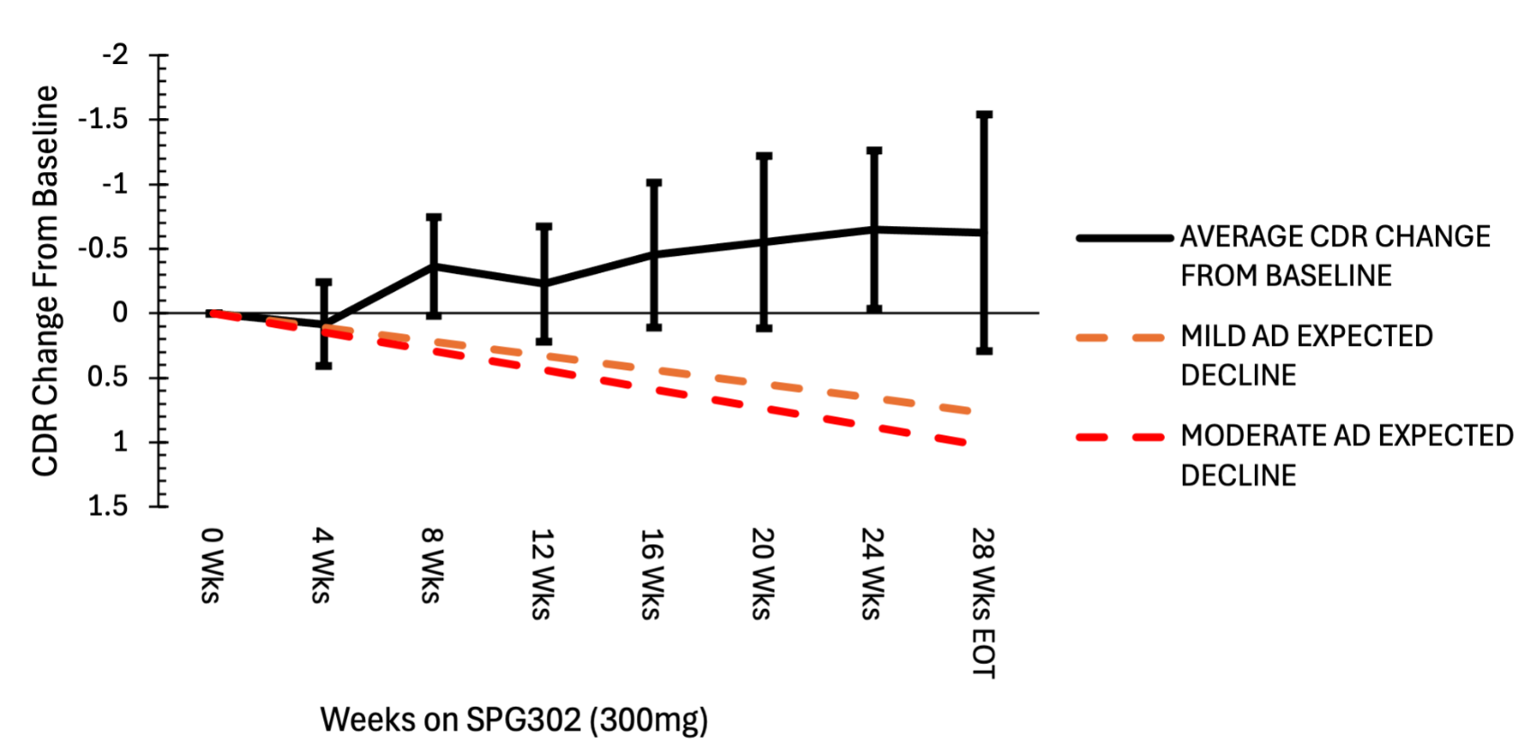
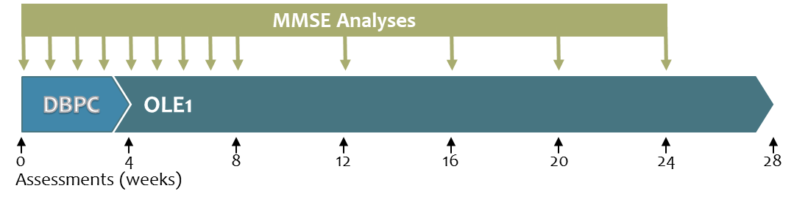
Early positive signals of cognitive outcomes in mild to moderate Alzheimer patients
treated with the synaptic regenerative small molecule, SPG302
Lauren Priest¹, Bruce Brew², Aimee Cazyer¹, Valerie Bramah², Pete Vanderklish³, Craig Erickson³, Christopher Schuring^{3,} Sharron Gargosky³, Stella Sarraf³
¹ Flinders Medical Center, Australia; ² St Vincent’s Hospital, Australia; ³ Spinogenix, USA
Background
Results
Spinogenix has developed a novel small molecule synaptic regenerative therapy, SPG302, to restore synapses in AD (and other synaptopathies), with the goal of helping patients recover lost function.
This poster presents findings from a Phase 2a trial of SPG302 in AD participants (NCT06427668).
Glutamatergic synapse loss is a major proximal cause of cognitive decline in Alzheimer’s disease (AD) that essentially uncouples cortical-limbic circuits involved in learning, memory and cognition¹⁻⁶. Most glutamatergic synapses lost in AD have dendritic spines as the postsynaptic element. Studies of spine F-actin regulatory proteins link the loss of axospinous synapses in particular to cognitive decline. Accordingly, retention of dendritic spine synapses is associated with cognitive resilience in the context of AD molecular pathology and in normal aging⁷⁻⁹. Preclinical studies in an AD mouse model support the hypothesis that synaptic regeneration with SPG302 may be efficacious in AD¹⁰.
Results from an initial cohort of mild-to-moderate AD participants treated with 300mg oral SPG302 q.d. (NCT06427668) are presented.
Demographics (300mg cohort)
Baseline SMMSE Scores
SPG302 and Other Treatments
SPG302 PK in AD Participants
AGE
n | 13
Mean | 71.6
SD | 8.9
Median | 73.5
Minimum | 51
Maximum | 81
Sex
Female | 62%
Male | 38%
Woman of Childbearing Age
Yes | 0%
No | 100%
Race
American Indian / Alaska Native | 0%
Asian | 0%
Black or African American | 0%
Native Hawaiian or Other Pacific Islander | 0%
White | 92%
Not Reported | 0%
Other | 8%
Unknown | 0%
Ethnicity
Hispanic or Latino | 0%
Not Hispanic or Latino | 100%
Not Reported | 0%
Unknown | 0%
Drug | # of Patients
Donepezil | 2
Memantine | 1
Normal cognitive function: 27-30
Mild Cognitive Impairment: 21-26
Moderate Cognitive Impairment: 10-20
Severe Cognitive Impairment: <10
SPG302 in combination with standard of care therapeutics was well tolerated
Participant recruitment balanced between mild and moderate AD stages as defined by SMMSE
PK in AD patients appears to be comparable to that observed in healthy adults.
Safety & Tolerability
SPG302 Favorable profile vs approved therapeutics
SPG302
Grade | ALL Adverse Event Terms (not related)
1 | Numbness on Right Index Finger
1 | Increased Fatigue & Tiredness
1 | Exacerbation of Hypertension
1 | Patient appeared to be slightly off, depressed and slightly elevated
1 | Depression family stress as precipitant
1 | Cough & Malaise
1 | Bloody Stool (pt has history of haemorhoids)
1 | Urinary Tract infection
2 | Benign Paroxysmal Positional Vertigo
2 | Tooth Extraction
2 | Tooth/ Gum infection
SPG302 was generally safe and well tolerated in AD participants
There were no severe (SAEs) or treatment-related adverse events (TRAEs)
4/13 patients experienced an AE unrelated to SPG302
Most were Grade 1 and resolved
SPG302 is
novel, first-in-class
rapid-acting
synaptic regenerative
small molecule administered as an oral tablet
regenerative – promotes the formation of new dendritic spine synapses
Safety & Tolerability in AD participants mirrors the excellent profile observed in healthy adults in Phase 1. Combined with its ease of administration as a once-a-day oral tablet, this profile suggests SPG302 may have distinct advantages in terms of safety and compliance relative to existing SOC treatments, including monoclonal antibodies targeting amyloid beta.
Illustration of SPG302 effects on dendritic spine density in vivo (CA1 apical dendrites)
SPG302 found to restore synaptic density within 2-4 weeks of daily treatment in preclinical models^{10,11} and in 3 species (mouse, rat, dog)
Efficacy – SMMSE
Conclusions
Preclinical POC in AD
SMMSE 4-week placebo-controlled period
SMMSE 24-week open label period
(weeks on treatment)
SPG302 was generally safe and well tolerated
Evidence of rapid improvement (SMMSE) within a 4-week placebo-controlled period is consistent with observations of rapid efficacy in preclinical models
Durable improvements in both SMMSE and CDR-SB
These early Phase 2a efficacy comparisons show competitive improvements in MMSE and CDR vs current standard of care therapies.
Daily treatment for 4 weeks sufficient to rescue synaptic density and memory deficits (NIH funded 1R43AG058278)
Trujillo-Estrada et al, 2021 – 3xTg AD mouse model
SPG302 Reverses Synaptic and Cognitive Deficits Without Altering Amyloid or Tau Pathology in a Transgenic Model of Alzheimer’s Disease (PMC8804111)
Daily treatment, 4 weeks, beginning at 6 months of age
CA1 Apical Dendrites
Morris Water Maze
Early results support the hypothesis that synaptic regeneration may be efficacious in restoring cognitive function in AD
SPG302 is also currently being evaluated in Phase 2a trials for ALS (NCT05882695) and schizophrenia (NCT06442462).
Phase 1 Summary
SPG302 was associated with rapid, significant and durable increases in SMMSE scores. The SMMSE is a brief cognitive test that assesses orientation, attention, memory, language, and visuospatial skills. While a score of 24 or more generally suggests normal cognition, scores below that can indicate varying degrees of cognitive impairment. In the first 4 weeks of DBPC, SPG302 increased SMMSE scores by > 2 pts. Typically, SMMSE scores decline by an average of 2 to 4 points per year (shown in the red dashed line). All patients showed a notable increase that was durable.
SPG302 was safe & well tolerated through 600mg in healthy volunteers
Single (SAD) and multiple (MAD) ascending oral doses from 25 to 600mg
No SAEs; 8 TRAEs (6 Grade 1, 2 Grade 2)
Dose proportional exposure, negligible food effect
T1/2 1-2hrs, no accumulation across days
Doses well below NOAEL achieved exposures in anticipated efficacy range
Database lock is underway and additional data will be presented at CTAD Dec 2025.
Efficacy – CDR-SB
Acknowledgements
SAD – AUC
SAD – Cmax
25mg
75mg
150mg
300mg
600mg
CDR-SB 4-week placebo-controlled period
CDR-SB 24-week open period
(weeks on treatment)
We want to give special thanks to the patients, their caregivers and family for participating in the trial.
We would like to thank the site staff and teams for all the efforts for this trial.
MAD – AUC
MAD – Cmax
Phase 2a Trial of SPG302 in AD
References Cited
DESIGN
Double blinded, Randomized (2:1), Placebo-controlled (4 weeks) period followed by an open label extension of 24 weeks in adults with Mild-to Moderate AD
4-week open label duration prompted by rapid activity of SPG302 in preclinical models
ENDPOINTS Presented
Safety / PK
Efficacy (as changes in):
  Standardized Mini-Mental State Examination (SMMSE)
  Clinical Dementia Rating Sum of Boxes (CDR-SB)
1. Selkoe DJ (2002) Alzheimer's disease is a synaptic failure. Science 298: 789-791.
2. DeKosky ST, et al. (1990) Synapse loss in frontal cortex biopsies in Alzheimer's disease: correlation with cognitive severity. Ann Neurol 27: 457-464.
3. Terry RD, et al. (1991) Physical basis of cognitive alterations in Alzheimer's disease: synapse loss is the major correlate of cognitive impairment. Ann Neurol 30: 572-580.
4. Scheff SW, et al. (2006) Alzheimer's disease-related alterations in synaptic density: neocortex and hippocampus. J Alzheimer's Dis 9: 101-115.
6. Mecca AP, et al. (2020) In vivo measurement of widespread synaptic loss in Alzheimer's disease with SV2A PET. Alzheimer's Dement 16: 974-982.
7. Boros BD, et al. (2017) Dendritic spines provide cognitive resilience against Alzheimer's disease. Ann Neurol 82: 602-614.
8. Walker CK, et al. (2021) Dendritic Spines: Mediators of Cognitive Resilience in Aging and Alzheimer's Disease. Neuroscientist 27: 487-505.
9. Guptarak J, et al. (2024) Cognitive integrity in Non-Demented Individuals with Alzheimer's Neuropathology is associated with preservation and remodeling of dendritic spines. Alzheimer's Dement 20: 4677-4691.
10. Trujillo-Estrada L, et al. (2021) SPG302 Reverses Synaptic and Cognitive Deficits Without Altering Amyloid or Tau Pathology in a Transgenic Model of Alzheimer's Disease. Neurotherapeutics.
11. Fogarty MJ, et al. (2023) Novel regenerative drug, SPG302 promotes functional recovery of diaphragm muscle activity after cervical spinal cord injury. J Physiol 601: 2513-2532.
SPG302 was associated with improvements in CDR-SB. The Clinical Dementia Rating Sum of Boxes (CDR-SB) score is an FDA-approvable endpoint used to assess the severity of dementia. The annual rate of change in CDR-SB scores can vary depending on the baseline CDR-SB stage: very mild AD (CDR 0.5), ~ 1.43 points per year; mild-moderate AD (CDR 1), ~ 1.91 points per year (SE = 0.07). SPG302 treatment in all individuals showed a stabilization that was durable over time.
SPG302 treatment was associated with rapid and significant improvements in SMMSE and CDR-SB measures, supporting the hypothesis that synaptic regeneration may improve symptoms in AD.

